Slide 1
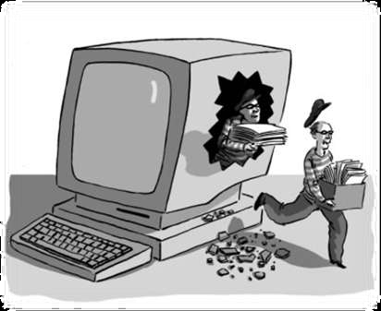
Data Security
Dr. Bhawana Rudra
NITK

Slide 2
Disclaimer: The images and the data has been taken form various websites.

Slide 3
In the modern era of information security violation and attacks increased on each day.
For data security we need to implement more strict policies in a way our business operations not blocked and execute smoothly.
Security Measures:
Prevent the physical access to the servers where data reside.
Implement operating system operations in more secure way.
Implement security models that enforce security measures.
DBA should implement the security polices to protect the data.

Slide 4
Database Security In General
Degree to which data is fully protected from tampering or unauthorized acts.
Comprises information system and information security concepts.

Slide 5
Information System
Information system (IS) comprised of components working together to produce and generate accurate information.
In IS wise decisions require
Accurate and timely information
Information integrity
IS categorized based on usage as
Low-level
Mid-level
High-level

Slide 6
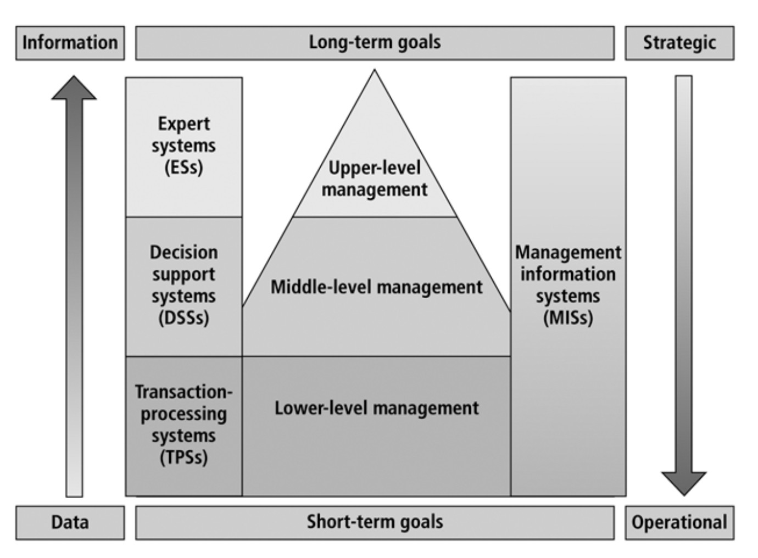
Market Analysis
Loan Expert
Financial Enterprise
Risk management
Fraud Detection
Sales Forecasting
Order Tracking
Customer Service
Student registration
Typical use of system applications at various management level

Slide 7
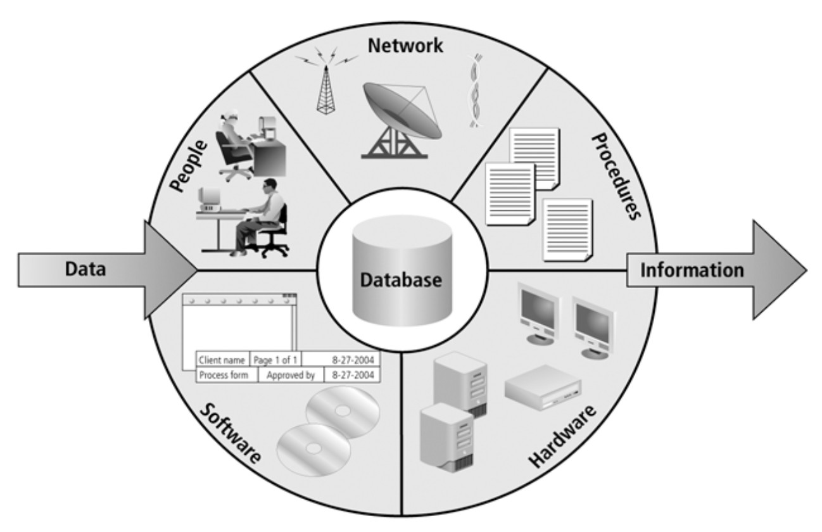
Information System Components

Slide 8
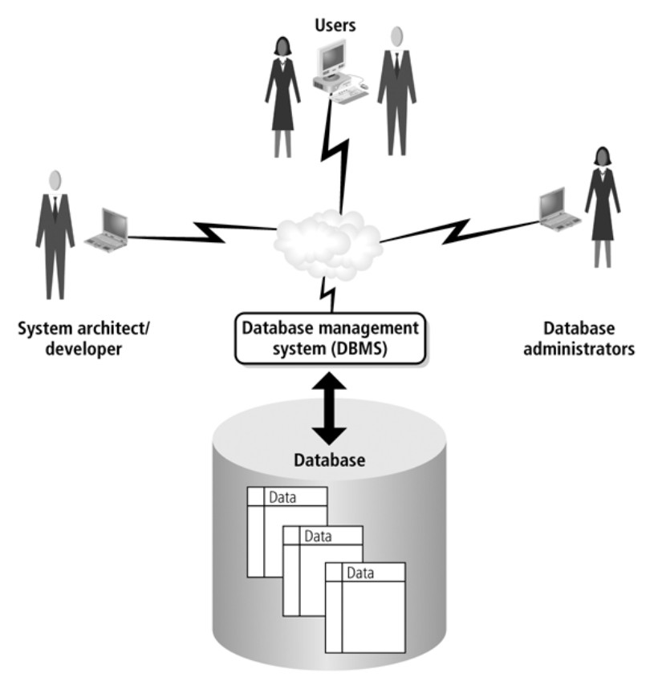
Database and DBMS Environment
DBMS Functions
Organize data
Store and retrieve data efficiently
Manipulate data (update and delete
Enforce referential integrity and consistency
Enforce and implement data security policies
and procedures
Back up, recover, and restore data
DBMS Components Data security …..

Slide 9
Information / Data Security
Information / data is one of the most valuable asset for any organization.
Its security consist of procedures and measures taken to protect information systems components.

Slide 10
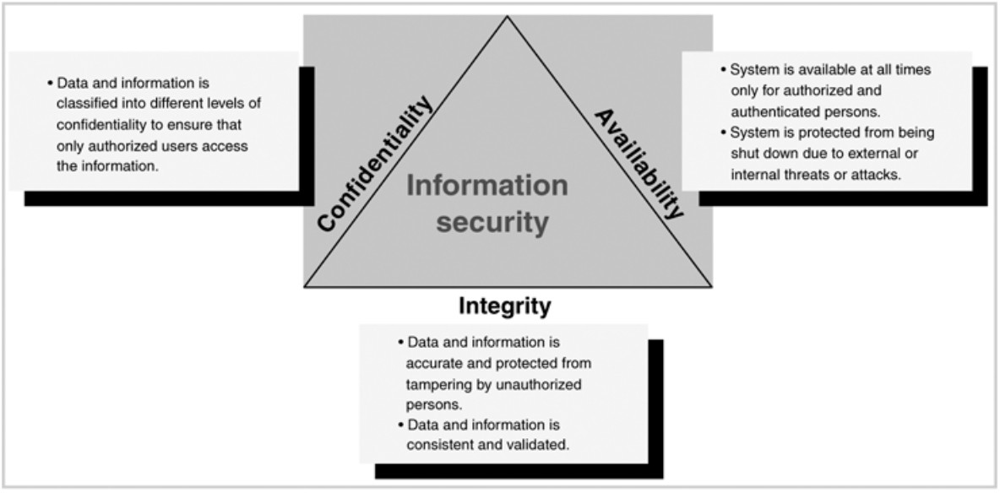

Slide 11
Database Security
Database security entertain allowing or disallowing user actions on the database and the objects within it.
DMBS contains Discretionary access control regulates all user access to named objects through privileges.
A privilege is permission to access a named object in a prescribed manner; for example, permission to query a table.
Privileges are granted to users at the discretion of other users.

Slide 12
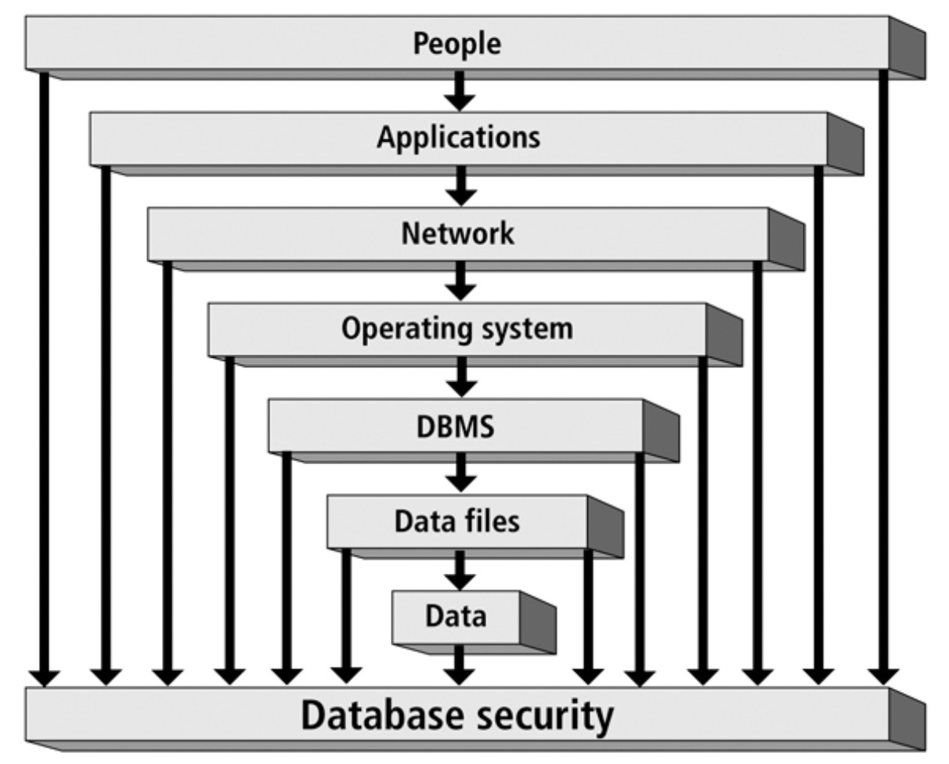

Slide 13
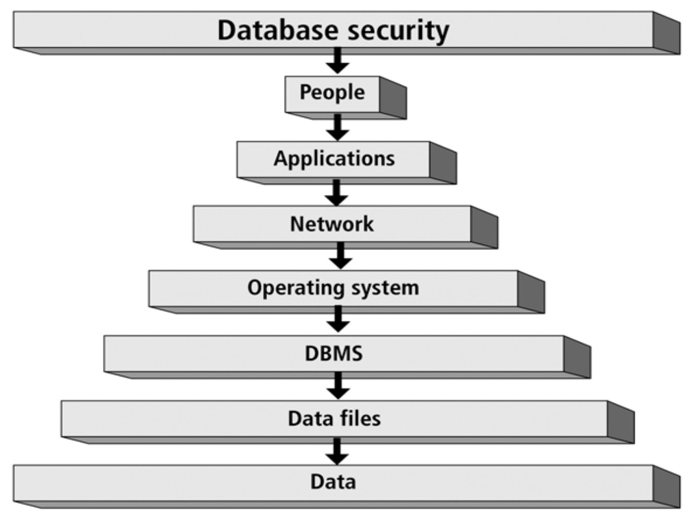

Slide 14
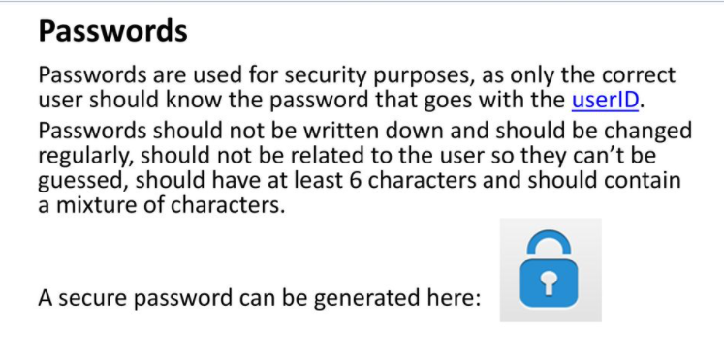

Slide 15
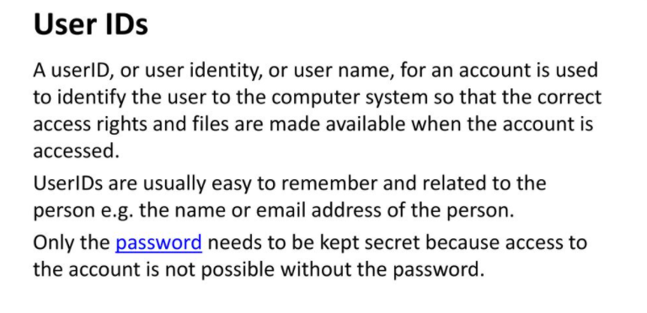

Slide 16
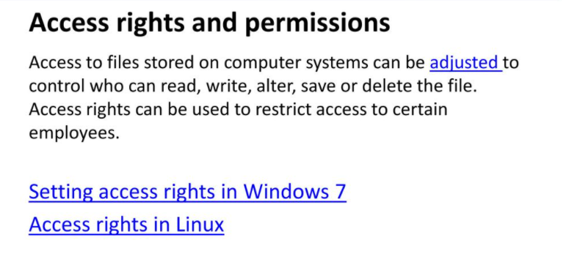

Slide 17
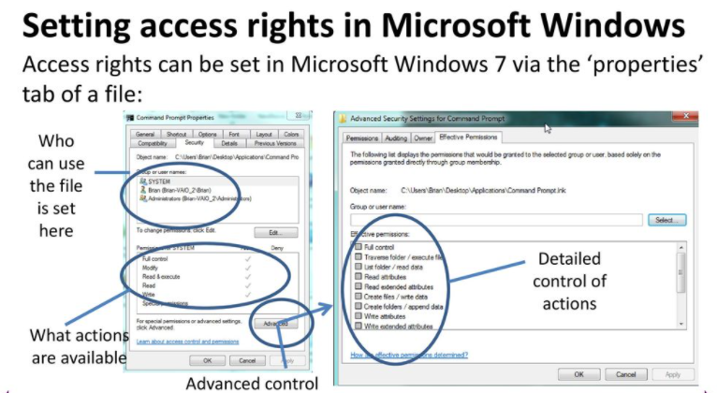

Slide 18
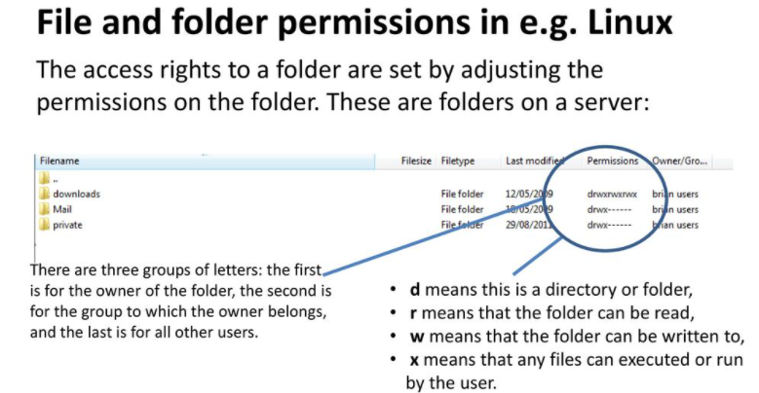

Slide 19
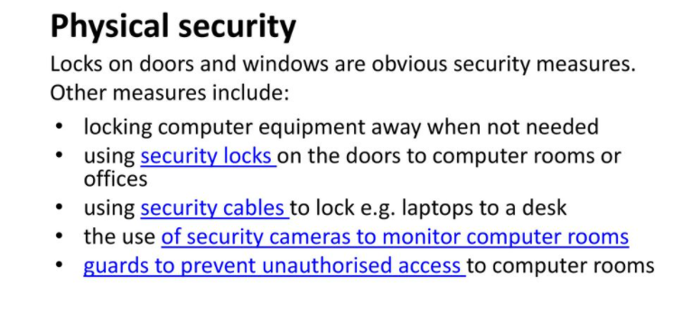

Slide 20
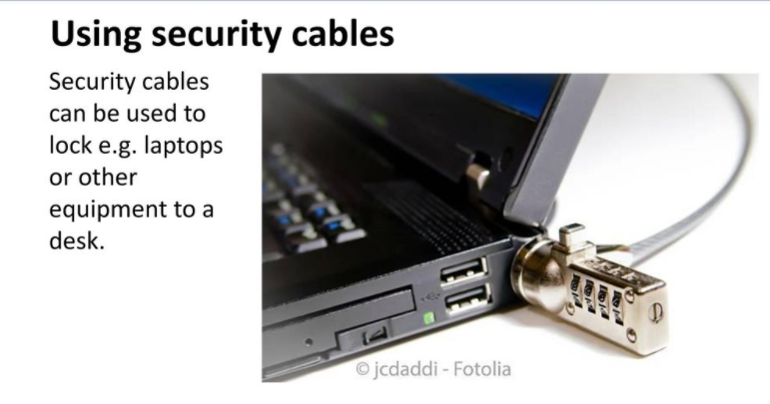

Slide 21
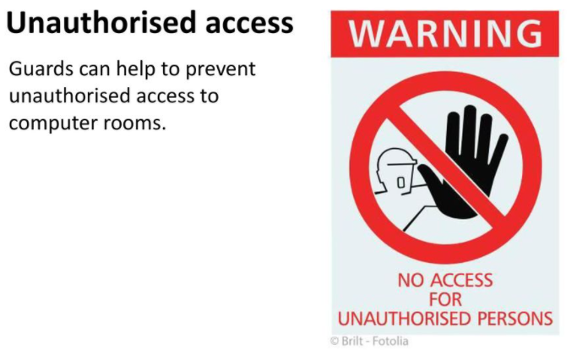
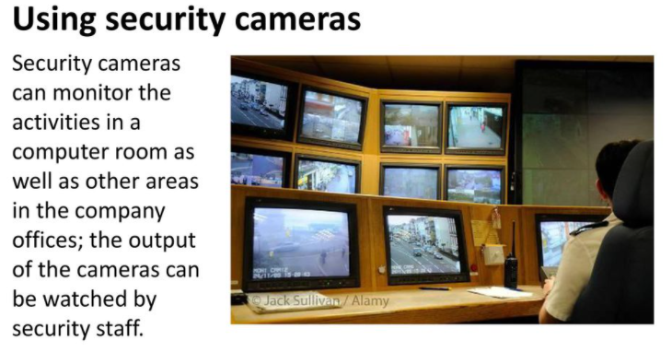

Slide 22
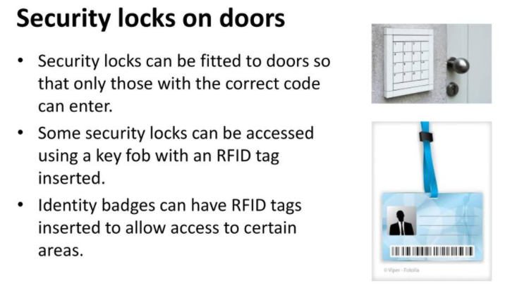

Slide 23
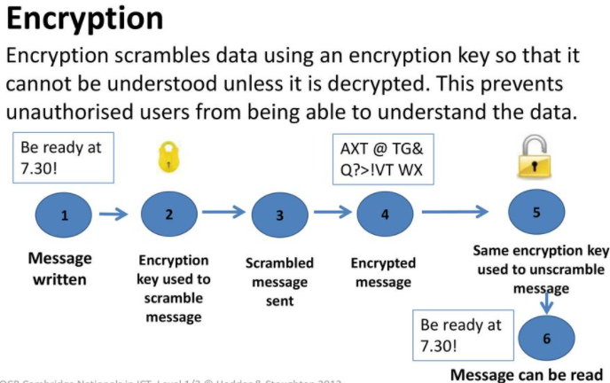

Slide 24
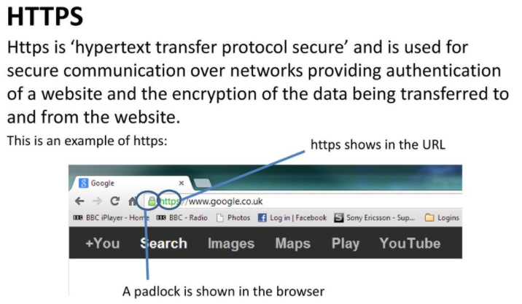

Slide 27
Security Policies and Memorandums
Data Access and Security Policy C-34
Applies to administrative computing resources regardless of where they reside. Its three major guiding principles are:
Access - To assure that employees have access to relevant data they need to conduct University business;
Data Security - To prevent unauthorized access to systems, data, facilities, and networks; and
Physical Security - To prevent any misuse of, or damage to, computer assets or data.
Security Policy C-34 specifically states that, “No University employee will knowingly damage or misuse computing resources or data. The employee's need to access data does not equate to casual viewing. It is the employee‘s obligation, and his/her supervisor‘s responsibility, to ensure that access to data is only to complete assigned functions.”

